Slide 1
Mark’s Autobiography
By Tom Kiddly

Slide 2
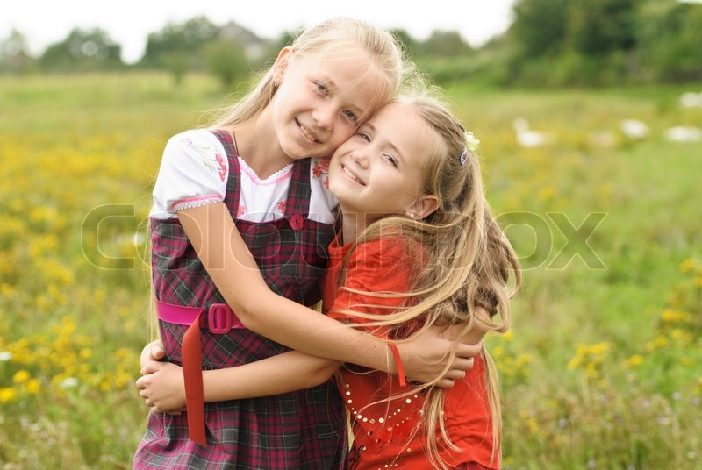
My Family
My mom and dad’s names are Delores and Mike
I have two sisters named Jody and Jill. Jody is older than me and Jill is younger.
Growing up I always had a dog or two as a pet. Some of their names were Lemon Drop, Cream Puff, Jello, and Sugar. My mom liked food names for pets.

Slide 3
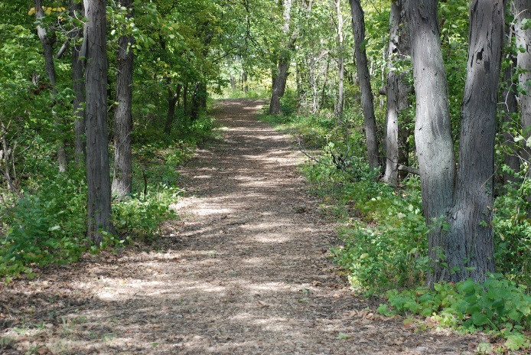
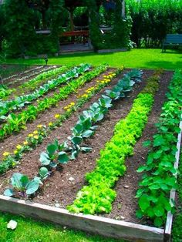
Interests
I enjoy taking hikes in the woods and also riding my bike on trails through the woods.
I love to grow food in the vegetable garden and flowers in about 13 curvy flower beds at home. My parents said I was born with a “green thumb”!

Slide 4
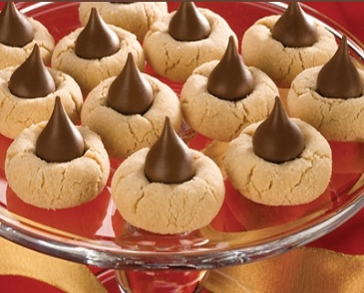
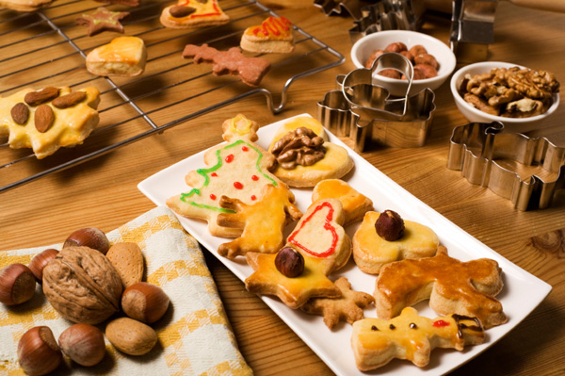
Memories
One of my favorite memories was staying at my grand parents house the night before Christmas. My nana was an excellent cook and baked the best Christmas cookies! I was her official taste tester!

Slide 5
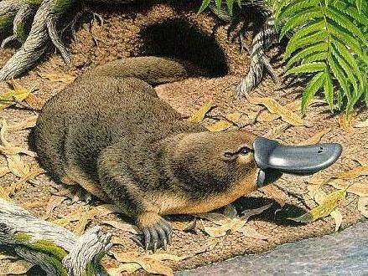
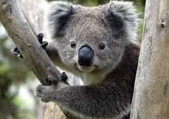
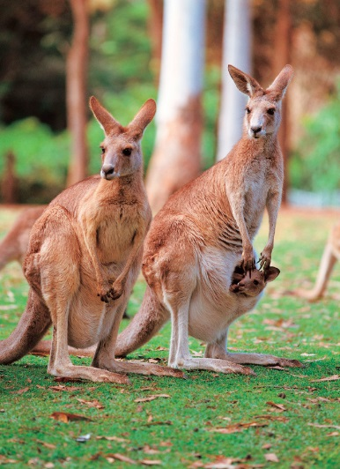
Future
Someday I would like to visit Australia to see kangaroos, koala, platypus, and all the unique animals from “Down Under”!

Slide 6
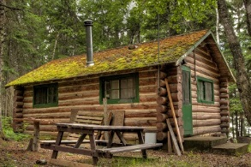
Surprise
I built a real log cabin cutting down the trees with an ax with a friend when I was 13 years old. We mudded the cracks between the logs during the winter!

